Slide 1
PANCARD VALIDATION
OOPC COURSE PROJECT
guided by- SAMPATH sir

Slide 2
TEAMATES 2003A51041 – PAGADALA SUSHMA 2003A51047 – BURA SAI NIKITHA

Slide 3
contents
Problem Statement
Objective
Solution
Algorithm
Input
Output
Justification
Concepts used
Vote of thanks

Slide 4
PROBLEM STATEMENT
Now-a-days PANCARD is one of the id proof for Indian citizens. Some people taking advantages and doing illegal things and frauds. Some people are misusing invalid PANCARD’s for their individual profits.

Slide 5
OBJECTIVE
The main objective of our project is to validate the PANCARD number and identify whether it is valid or not. Now-a-days PANCARD is one of the id proof for Indian citizens. Some people taking advantages and doing illegal things and frauds. By entering the particular 10 digit number it validates and identify whether the given PANCARD number is valid or invalid but here verification of PANCARD number do not take place.

Slide 6
SOLUTION
Generally, PANCARD number consists 10 characters. First 5 characters are uppercase alphabets then followed by 4 numerical characters and the last character is again an uppercase alphabet. By using this logic we can validate whether the given PANCARD number is valid or invalid.

Slide 7
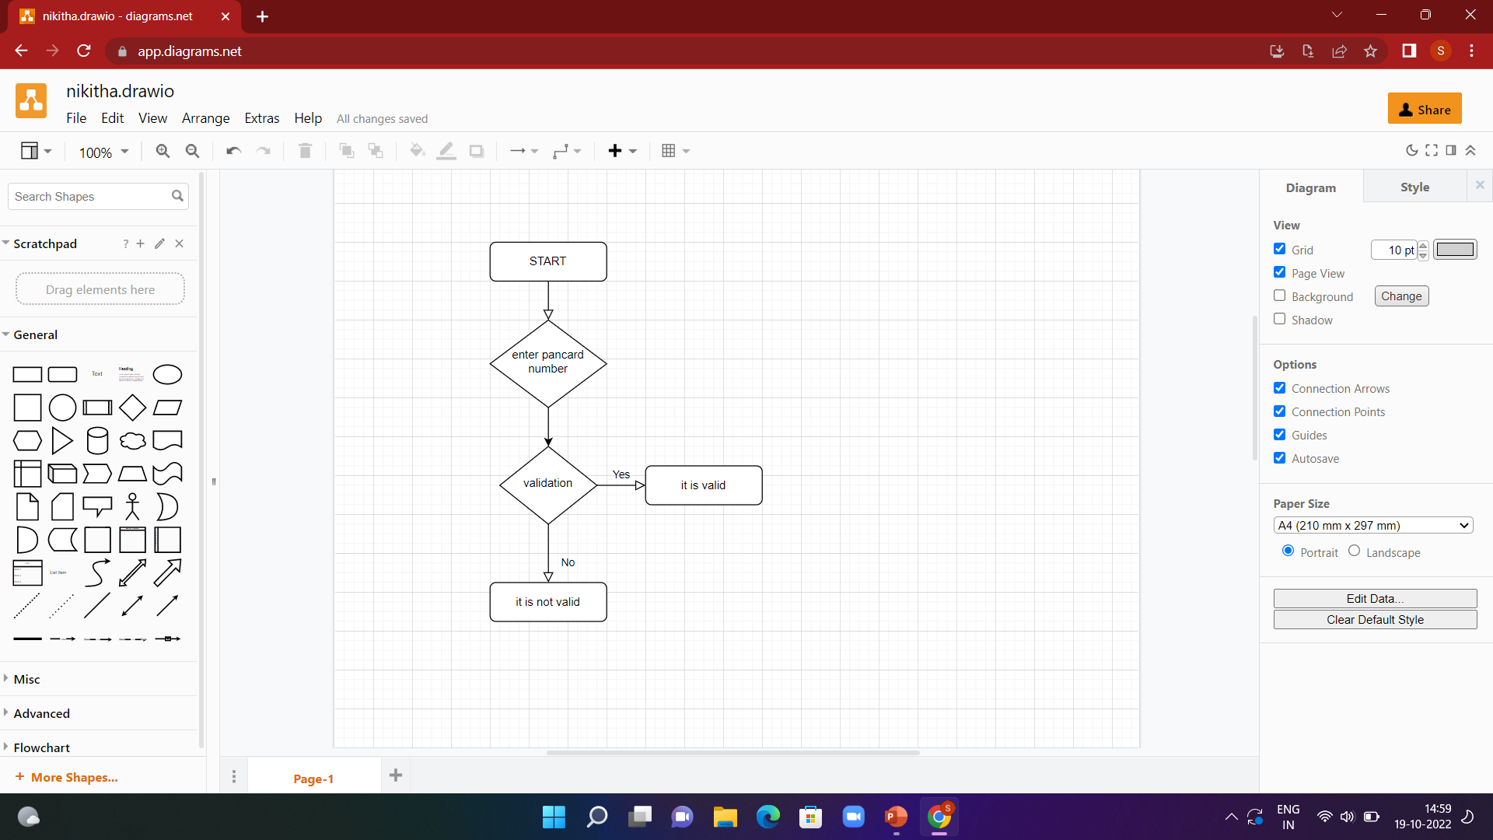
DATA FLOWCHART

Slide 8
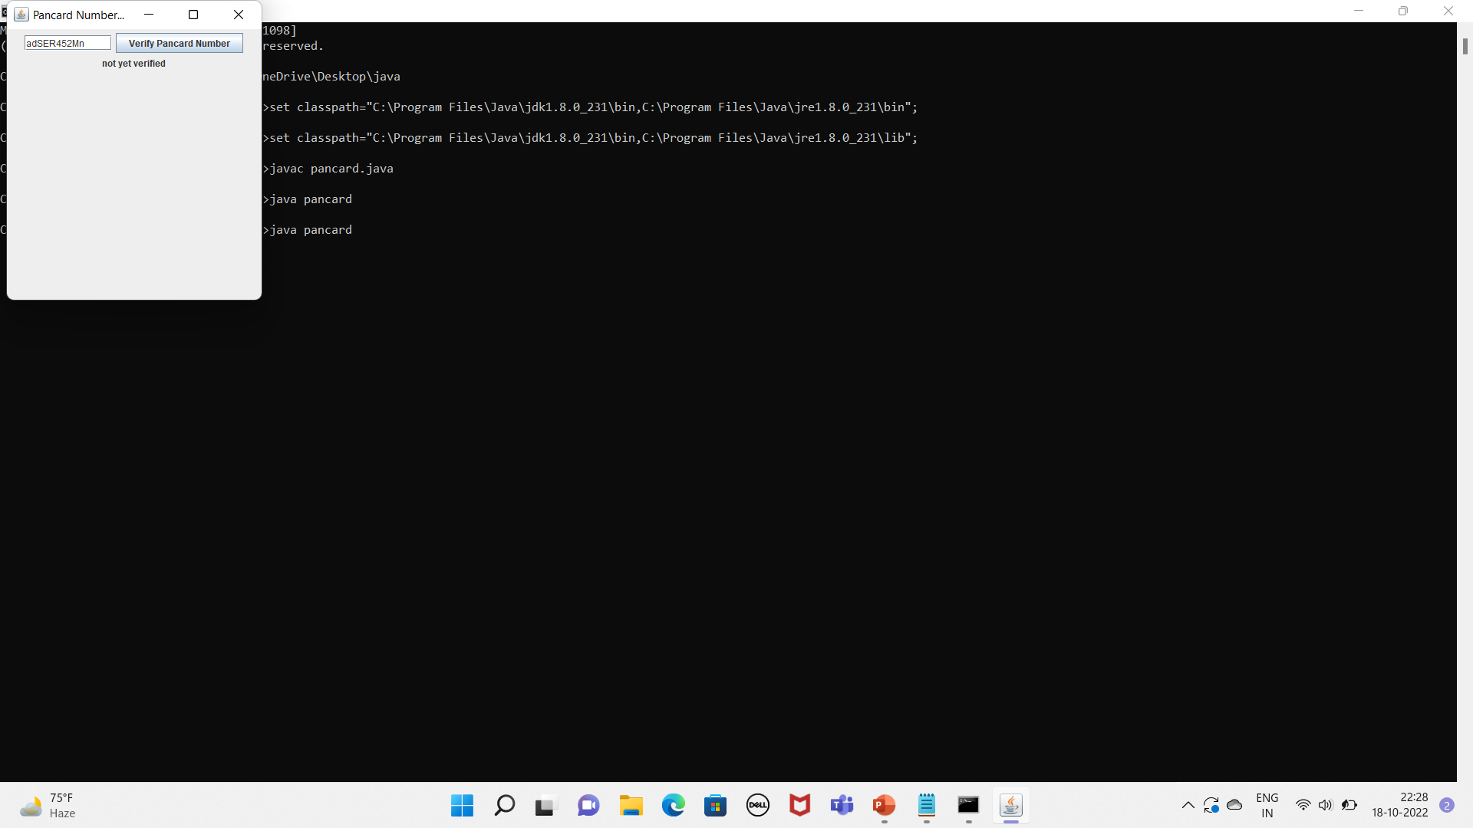
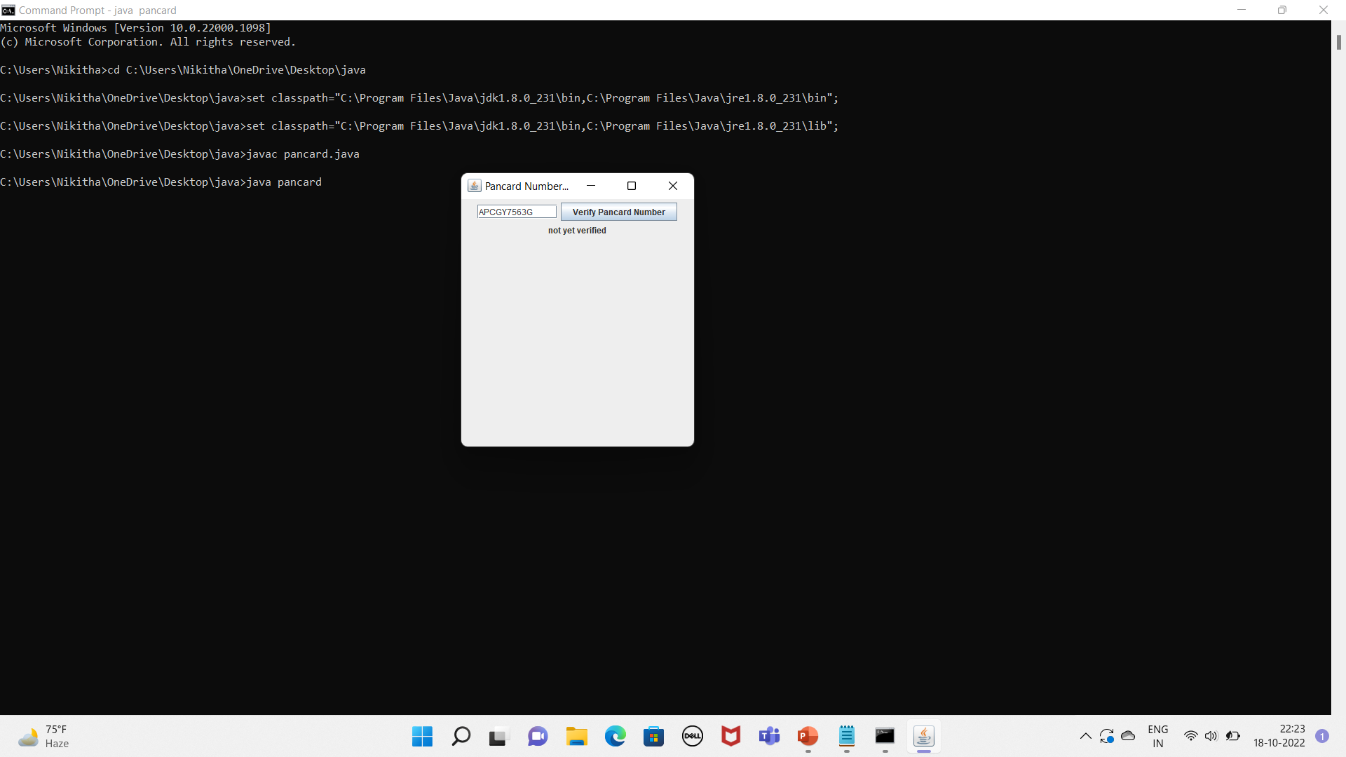
INPUT

Slide 9
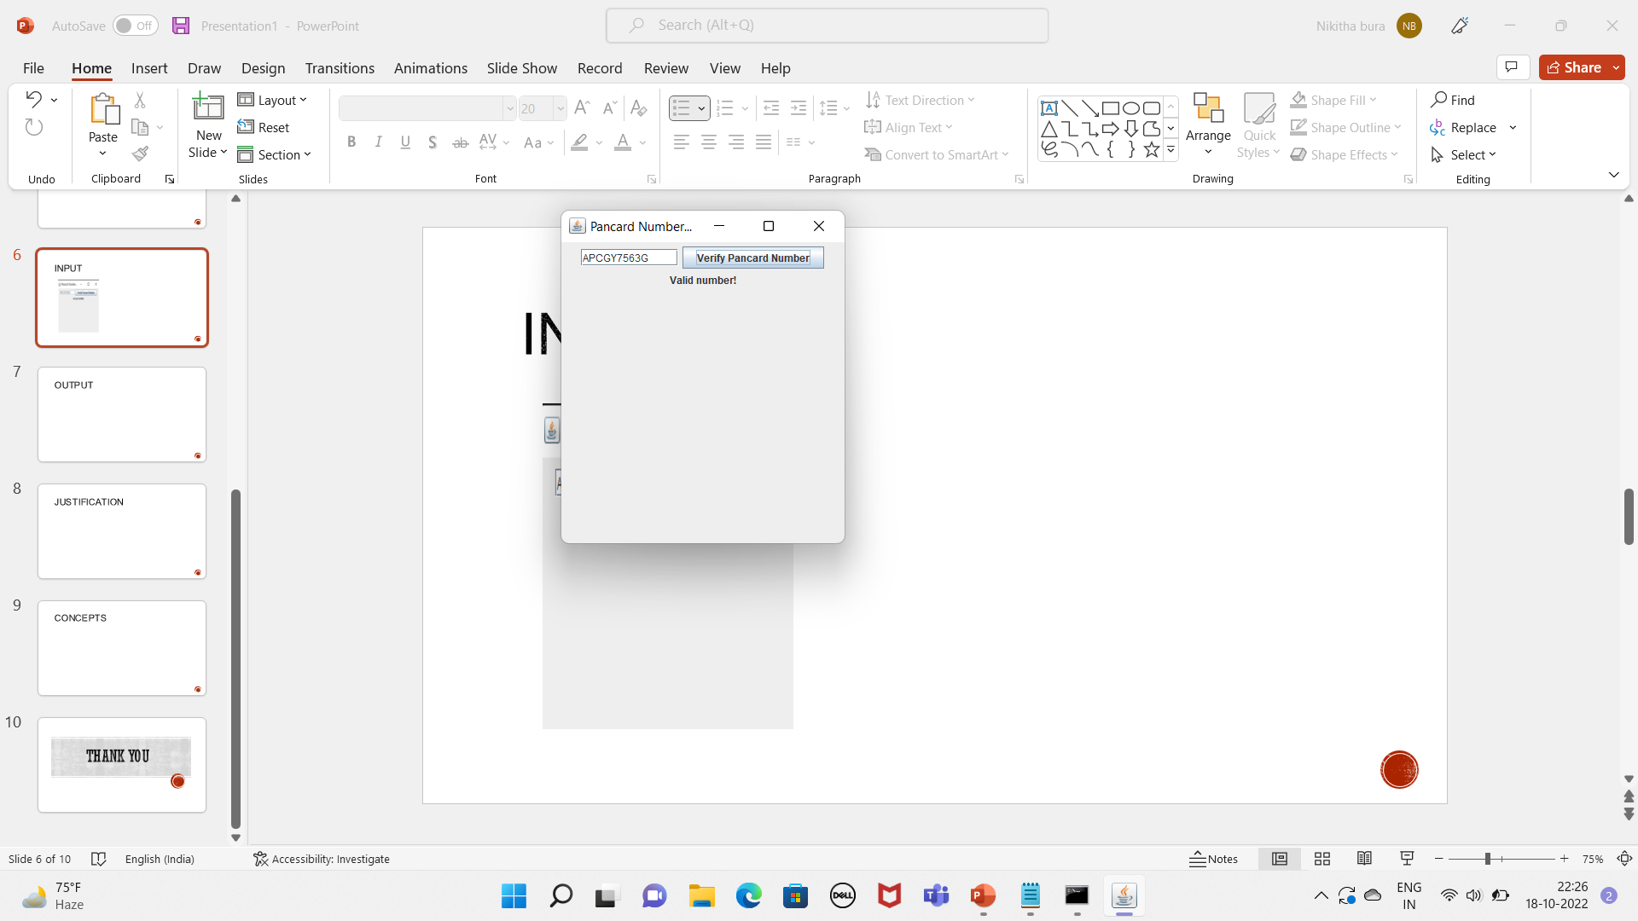
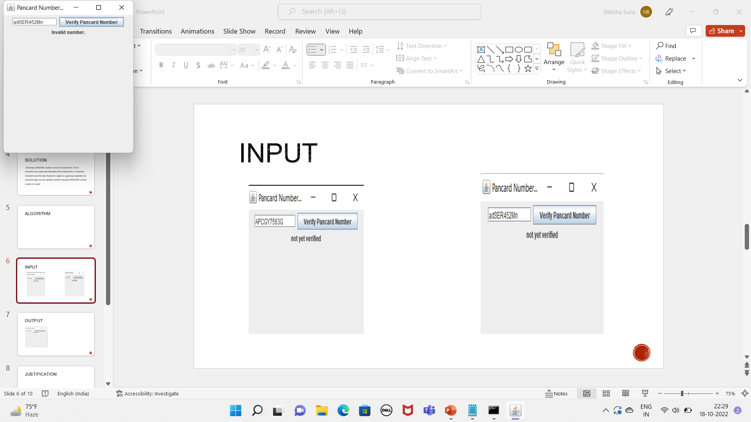
OUTPUT

Slide 10
JUSTIFICATION–oBjective is reached
This application gives whether the entered PANCARD number is valid or invalid by using algorithm and also with the help of logic( i.e. the particular pattern in which the PANCARD number should be present).
This applications validates the entered PANCARD number is valid or not so that the fake cards which are not in the particular format are recognized easily.

Slide 11
CONCEPTS USED
SWINGS

Slide 12
THANK YOU

